Slide 1
The Impact of COVID-19 in the United States
Caroline Yan
Gowtham Krishnakumar
Ken Yeh
Naomi Elizalde

Slide 2
Objectives
Overview and analysis of COVID-19 Data
COVID-19’s impact on the stock market
COVID-19’s impact on the housing market
Impact of Obesity on COVID-19

Slide 3
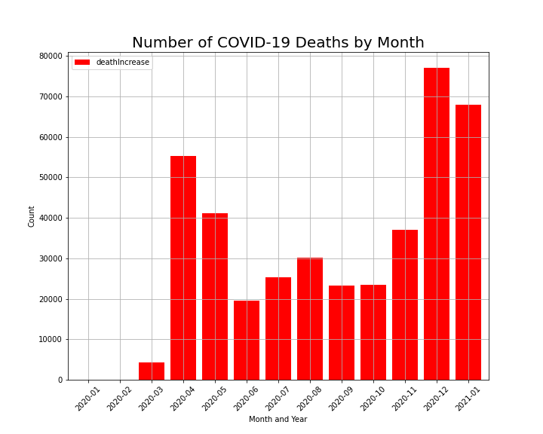
Exploratory COVID-19 Data
Initial Lockdown may have contributed to decreasing deaths
Further data would need to be collected to see if data cyclical
Source: https://covidtracking.com/data/national

Slide 4
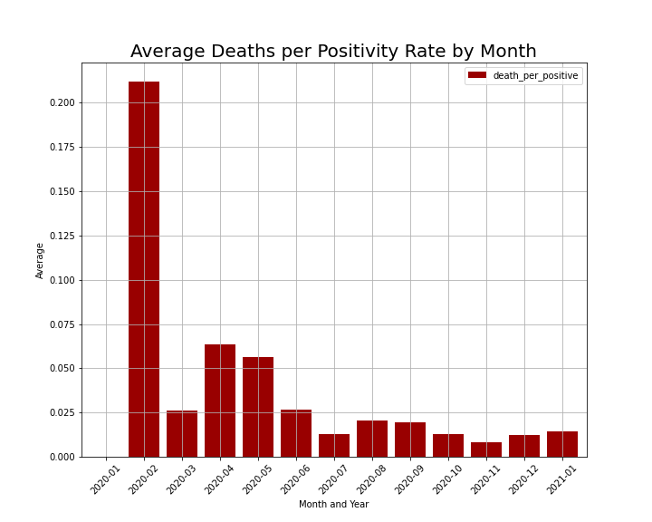
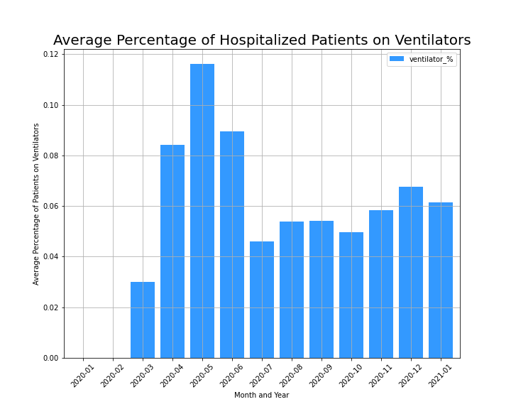
Data Manipulation
Created 2 new columns using existing data
Percentage of Ventilators normalized after July. Why?
Assuming hospital capacity is constant and more ventilators are being made, one can expect percentage of patients on ventilators should go up

Slide 5
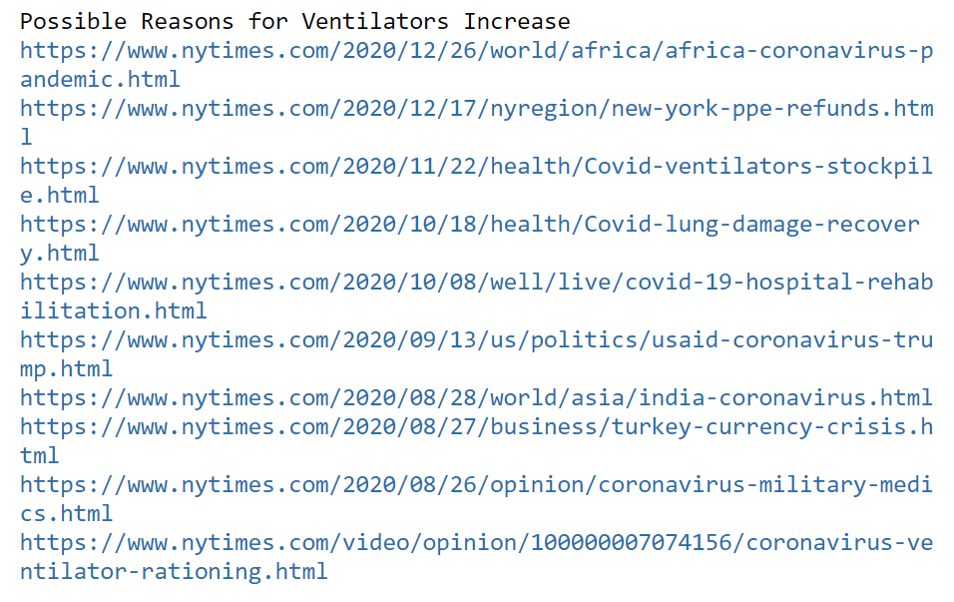
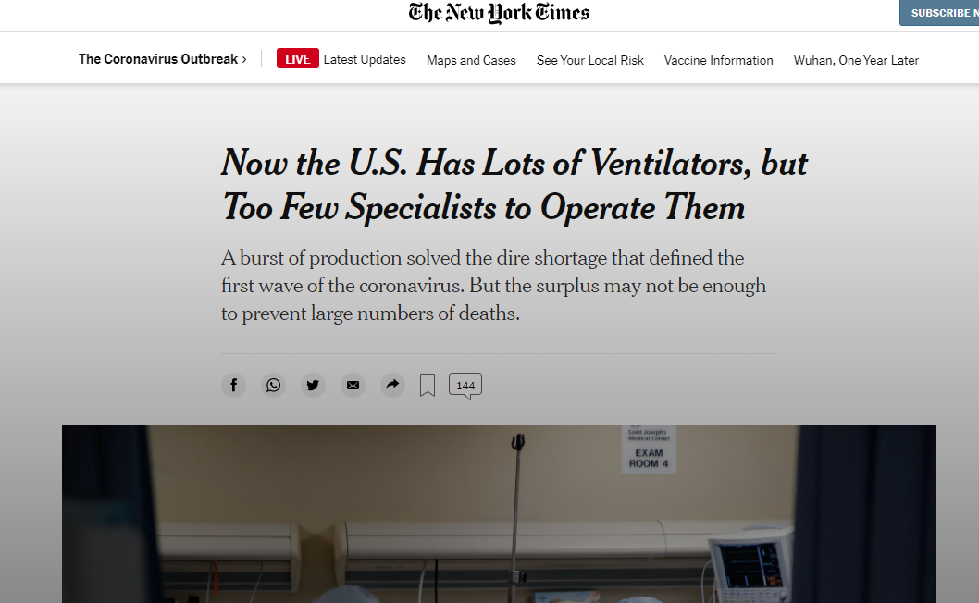
Using NYT API
Set query for articles for the past year regarding ventilators
One possible explanation for stabilization of percentage of patients on ventilators

Slide 6
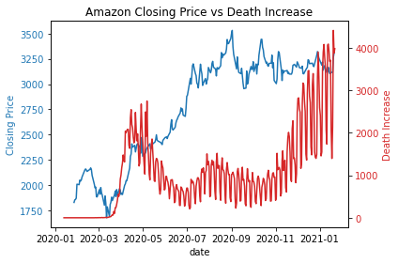
Amazon Stock Performance vs. COVID-19 Deaths
Being an online retailer, Amazon’s stock performance adjusted to the demands of a pandemic market well
Early dip in stock price in March quickly recovered in April and onwards.
Amazon’s business model was not affected by the pandemic
Stock Data Source: Yahoo Finance

Slide 7
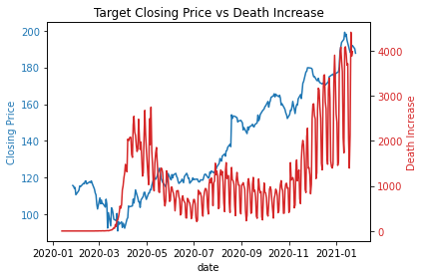
Target Stock Performance vs. COVID-19 Deaths
Being more of a brick-and-mortar store, one could assume that Target would have a harder time adjusting to the pandemic
The recovery from the initial lockdown dip took longer than that of Amazon, but Target made the necessary adjustments.
How were they able to achieve this?
Stock Data Source: Yahoo Finance

Slide 8
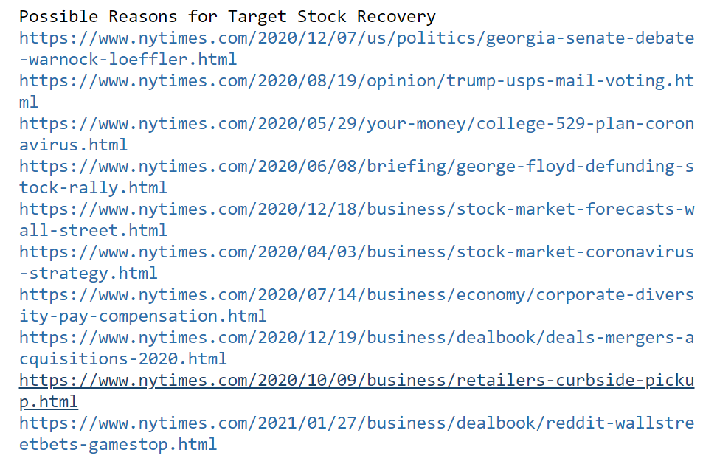
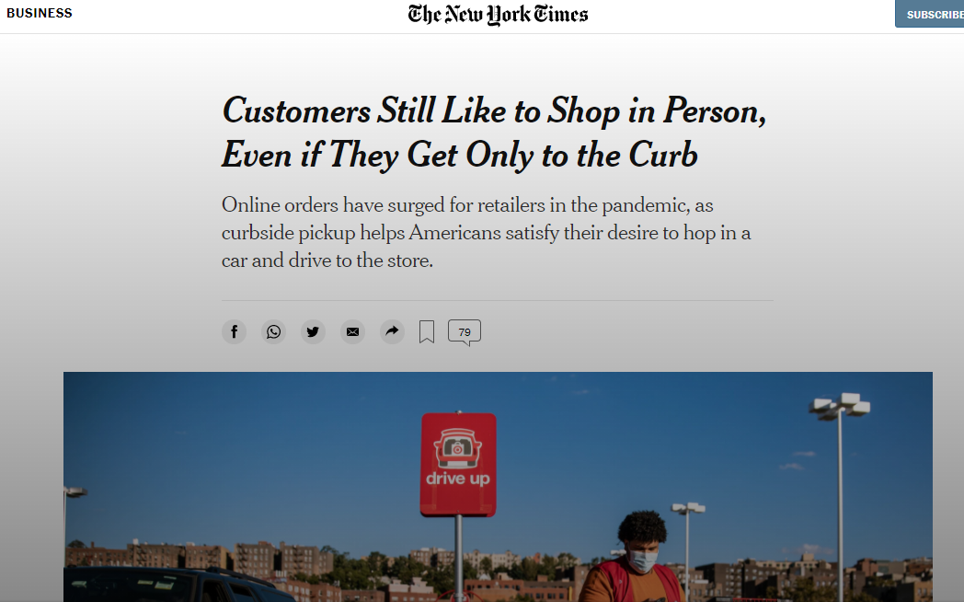
Using NYT API
Set query for articles for the past year regarding Target Strategy
Target adapted to a pandemic market by refining their curbside shopping experience

Slide 9
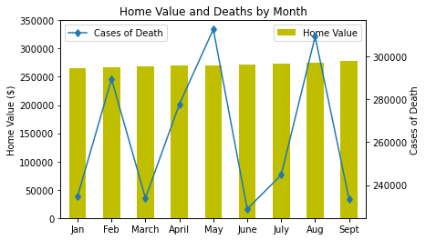
Home Index Value and Covid-19 Death Rates, United States
Zillow Home Index Value (ZHIV): A measure of the typical home value and market change. Specifically Single-Family Homes
As the number of Covid Death rates fluctuated, the ZHIV appeared to remain constant.
The typical home value of homes in the United States is around $266,000. This value includes the middle price tier of homes.
Source: https://www.zillow.com/research/data/

Slide 10
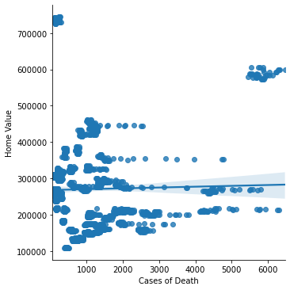
Home Index Value and Covid-19 Death Rates, United States
Final Conclusions:
No Correlation
Are the home values increasing or decreasing?
How does this affect Homeowners?
Sales, Refinances, Insurance premiums
https://www.zillow.com/research/data/

Slide 11
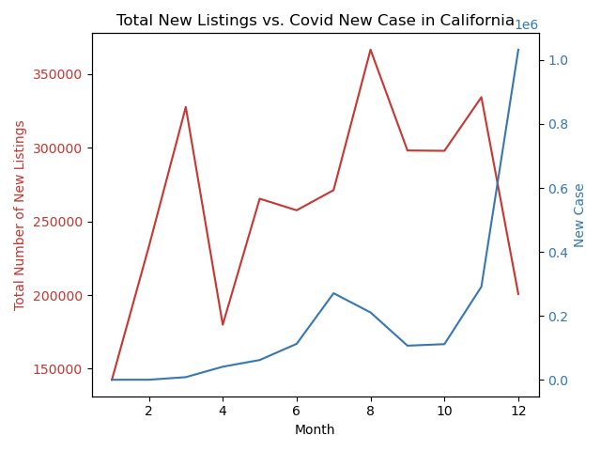
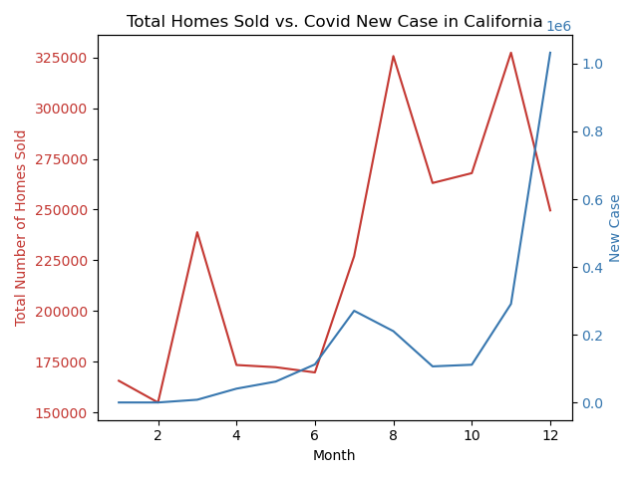
COVID-19’s impact on the housing market - California
Total number of new listing and total homes sold are similar in overall trend:
April is the month when most of the people stopped listing/buying their houses.
August is the month that COVID new case number is decreasing. Therefore people are more confident in listing and buying houses.
November is another peak of listing/buying activities, but the industry environment worsened in December, when COVID cases surged.

Slide 12
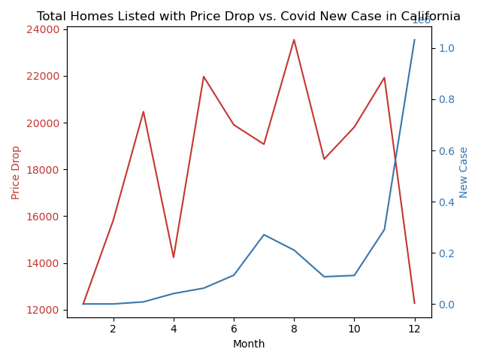
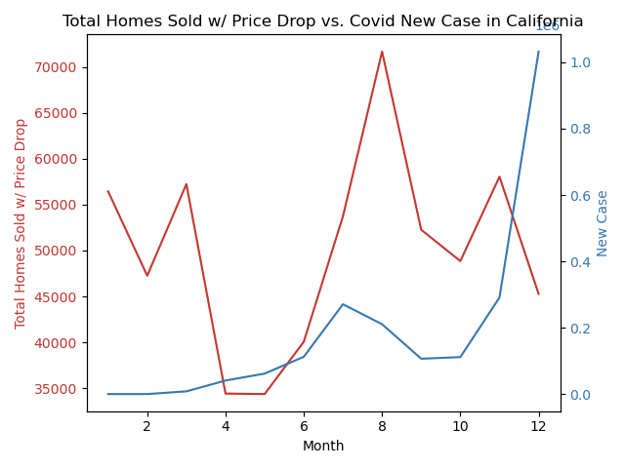
COVID-19’s impact on the housing market - California
Total number of new listing with price drop has a strong negative correlation with new COVID cases.
Total number of new homes sold with price drop demonstrates a similar trend with the total listing/sold number.
Does not have strong correlation with the number of COVID cases.
Possible reason: How people perceived the virus might be a more important element to consider, rather than the actual increase in covid cases.

Slide 13
Impact of Obesity on COVID-19
Obesity is defined as BMI over 30
Data Source: 2020 CDC data
Questions:
Do higher Obesity rates in states correlate to a higher amount of covid cases.
Do states which are on average obese (over 30) have higher covid rates specfically?

Slide 14
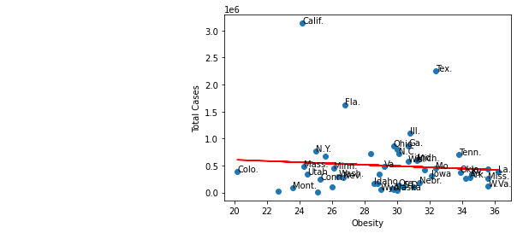
Regression Analysis
r^2 =
.006
No correlation
'y = -11693.55x + 842184.37'
Variables:
Weather
Pre Covid Obesity
Poverty
Government policy

Slide 15
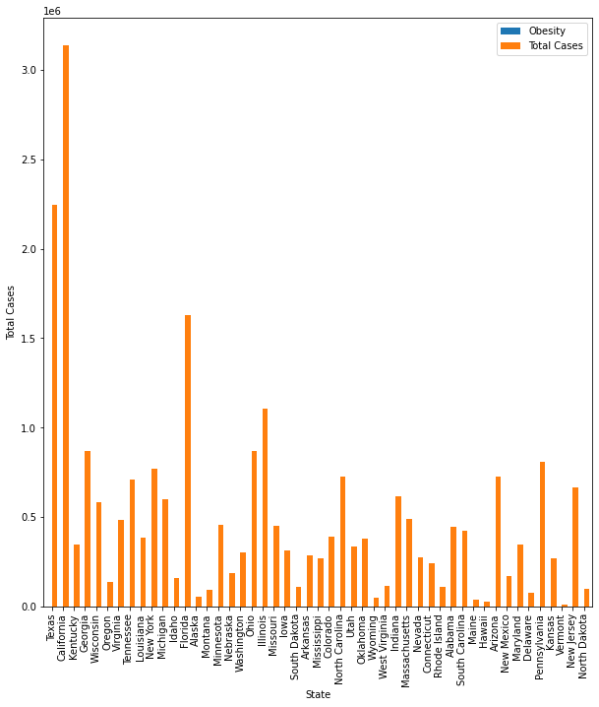
Covid Cases (in millions)

Slide 16
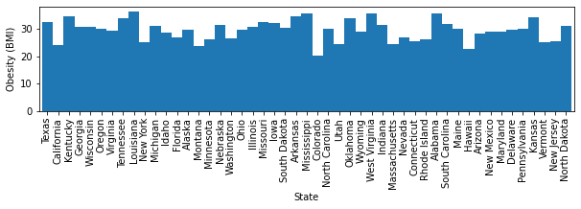
Obesity Data

Slide 17
Thank You For Your Time
Any Questions?

Slide 18
Sources
Stock Market Data Source
https://covidtracking.com/data/national
Yahoo Finance
Housing Market Data Source
Redfin Data: https://redfin-public-data.s3-us-west-2.amazonaws.com/redfin_covid19/weekly_housing_market_data_most_recent.tsv
CDC data by state: https://healthdata.gov/dataset/united-states-covid-19-cases-and-deaths-state-over-time
https://www.zillow.com/research/data/
https://data.cdc.gov/NCHS/Weekly-Counts-of-Deaths-by-State-and-Select-Causes/muzy-jte6
Obesity Data Source

